Slide 1
Frequency Response Analysis

Slide 2
Frequency response of a control system refers to the steady state response of a system subject to sinusoidal input of fixed (constant) amplitude but frequency varying over a specific range, usually from 0 to ∞
For linear systems the frequency of input and output signal remains the same, while the ratio of magnitude of output signal to the input signal and phase between two signals may change.

Slide 3
Frequency response analysis is a complimentary method to time domain analysis (step and ramp input analysis). It deals with only steady state and measurements are taken when transients have disappeared.
linear system is subjected to a sinusoidal input. I(t) = a Sin wt and the corresponding output is O(t) = b Sin (wt + Ф)
as shown in Figure

Slide 4
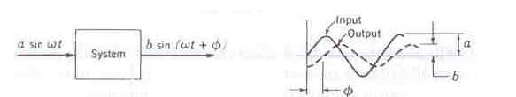
The following quantities are very important in frequency response analysis.
M (w) = b/a = ratio of amplitudes = Magnitude ratio or Magnification factor or gain.
Ф (w) = Ф = phase shift or phase angle

Slide 5
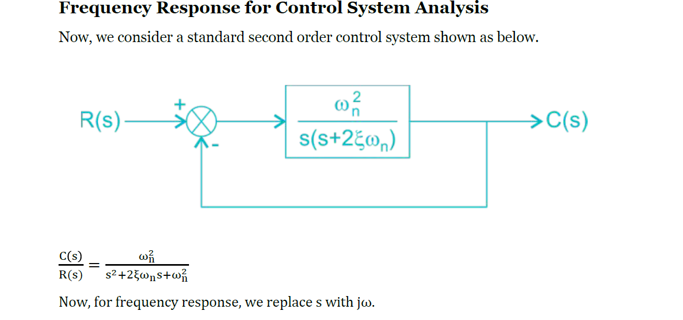

Slide 6
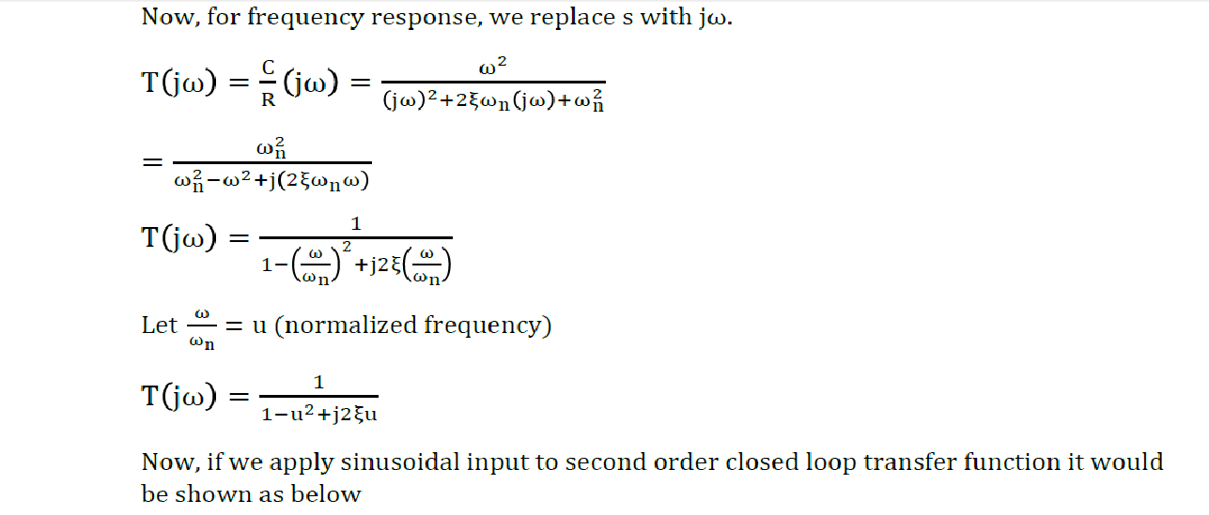

Slide 7
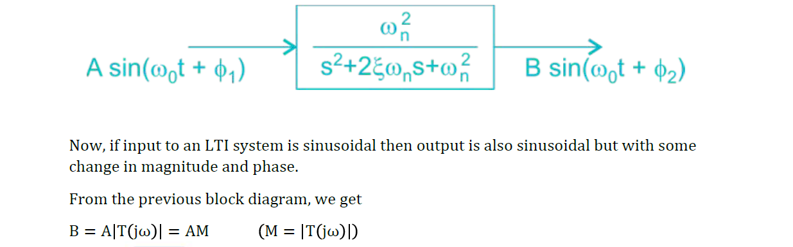

Slide 8
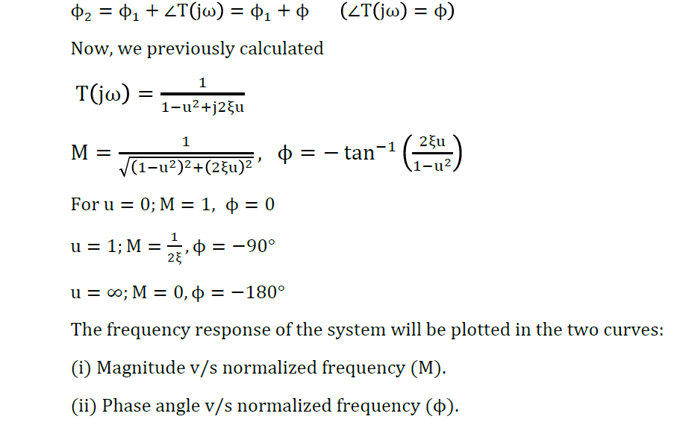

Slide 9
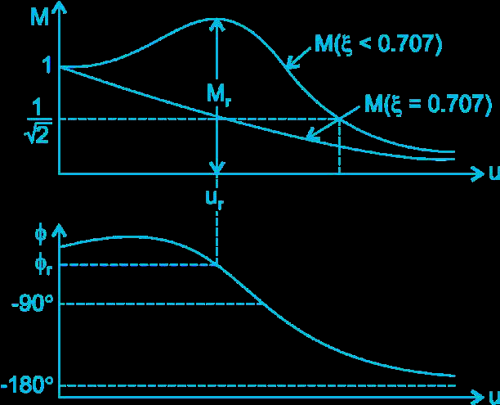

Slide 10
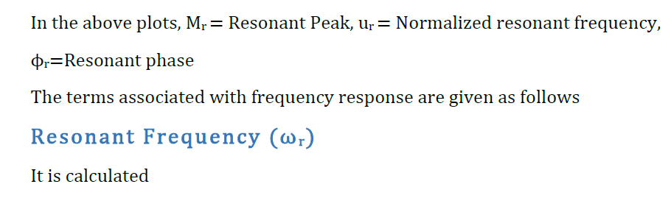
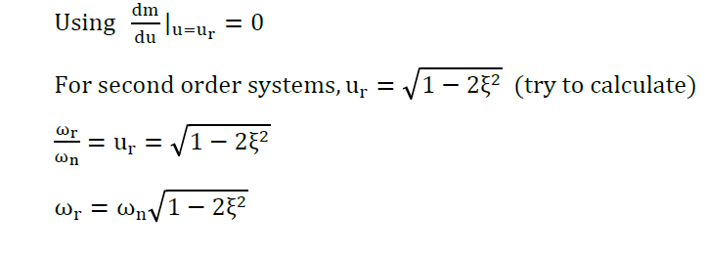

Slide 11
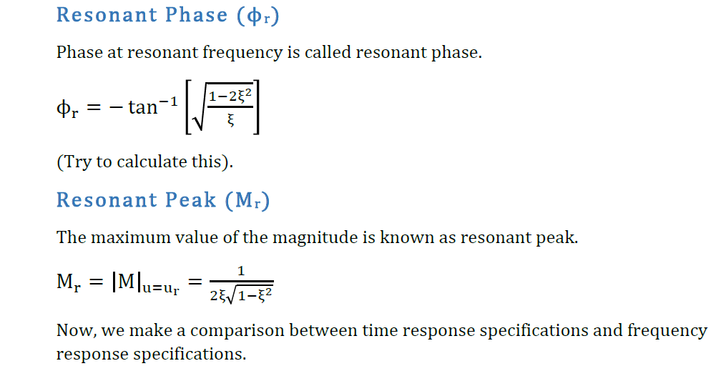

Slide 12
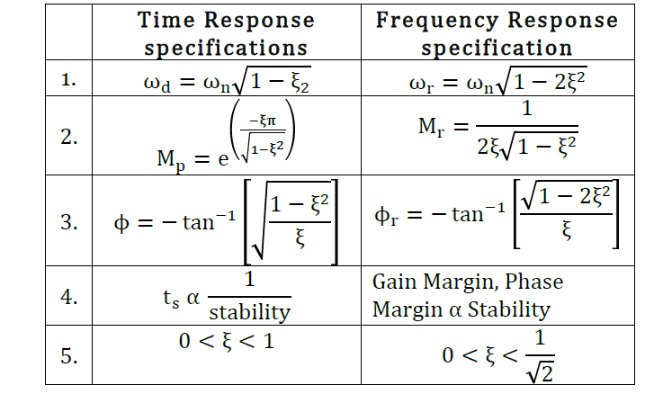

Slide 13
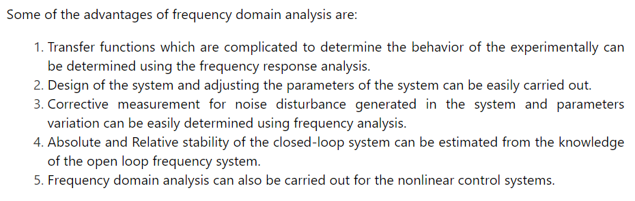

Slide 14
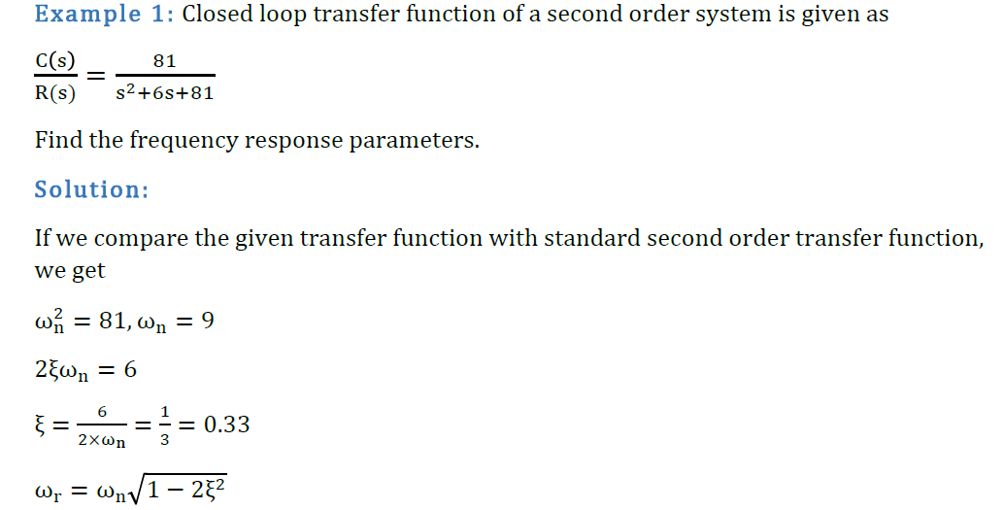

Slide 15
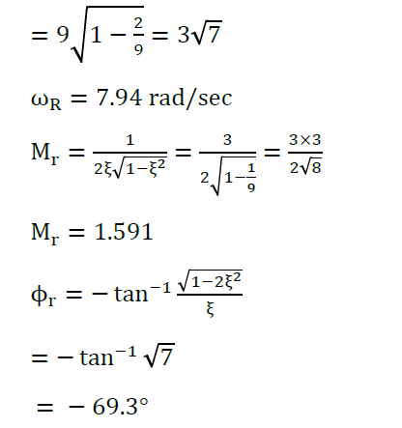

Slide 16
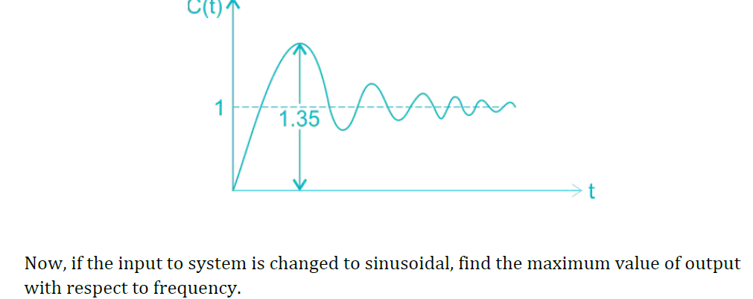

Slide 17
